Slide 1



Automated Blood Cell count from Smear Images for COVID Diagnosis
Parshin Shojaee, Ph.D. Student, Industrial and Systems Engineering
NouShin OMIDVAR, Ph.D. Student, Chemical engineering
MaY 5, 2021

Slide 2
Problem statement
Current gold standard in confirmation of covid-19 infection: (rRT-PCR)
Shortcoming :
Long turnaround times (3-4 hours to generate results),
Potential shortage of reagents,
False-negative rates as large as 15-20%,
The need for certified laboratories, expensive equipment and trained personnel
Need for alternative, faster, less expensive and more accessible tests.

Slide 3
Our Solution
The diagnosis of blood-based diseases often involves identifying and characterizing patient blood samples.
Developing an automated methods to detect, classify and count blood cell subtypes for medical applications.

Slide 4
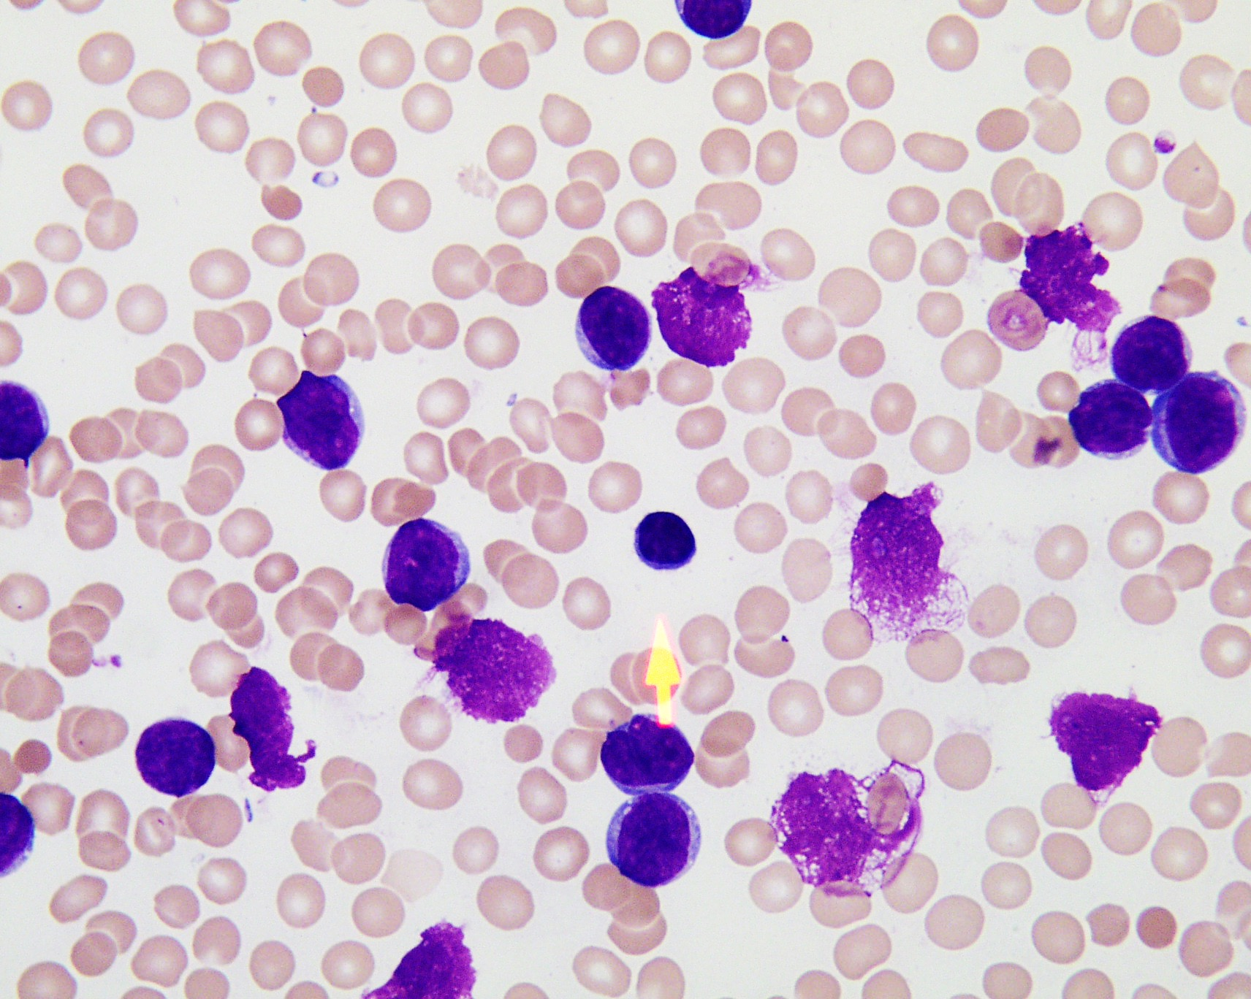
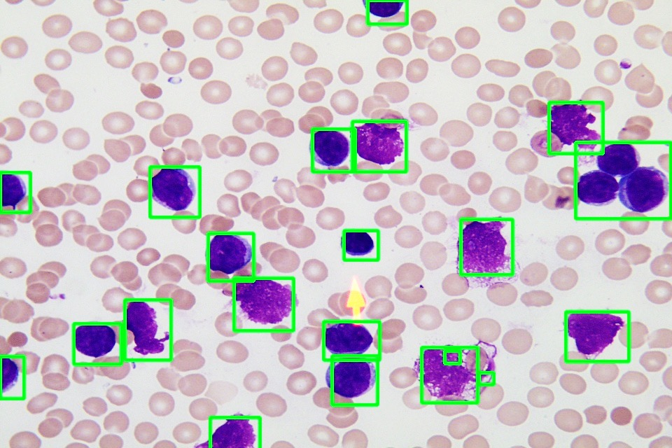
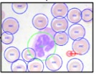
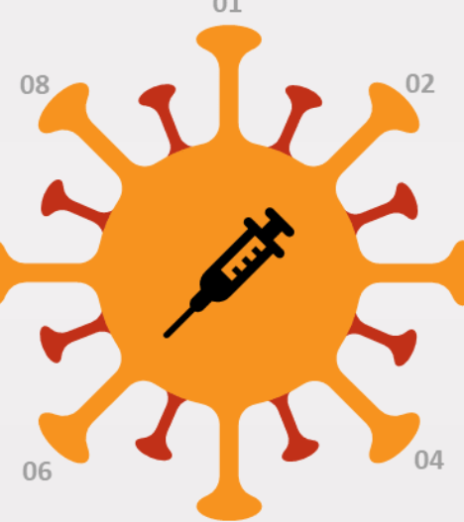
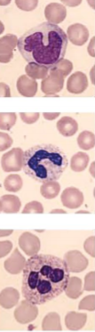
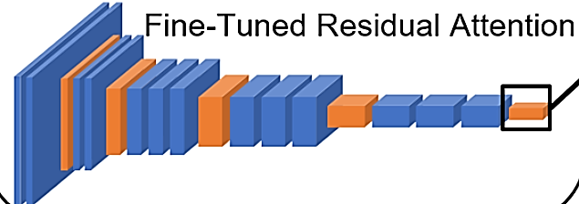

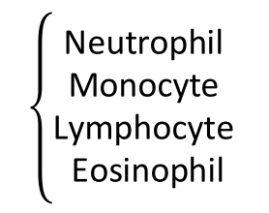
Project Pipeline
Task 1
WBC Detection
RBC and Platelets Detection
Pipeline
Task 3
Smear Image
WBC Sub-images
RBC Cell Count
Platelets Cell Count
WBC Cell Count
WBC Cell Type Count
Machine Learning Classifiers
Task 2
Classification of WBC Cell Type
$$\left\{\begin{aligned}COVID \\ Non−Covid\end{aligned}\right.$$
$$\left\{\begin{aligned}\text{Neutrophil} \\ \text{Monocyte} \\ \begin{matrix}\text{Lymphocyte} \\ \text{Eosinophi}\text{l}\end{matrix}\end{aligned}\right.$$
Data set 2: COVID-19 Diagnosis Based on Blood Cell Counts
Data set 1: Blood Smear Images

Slide 5
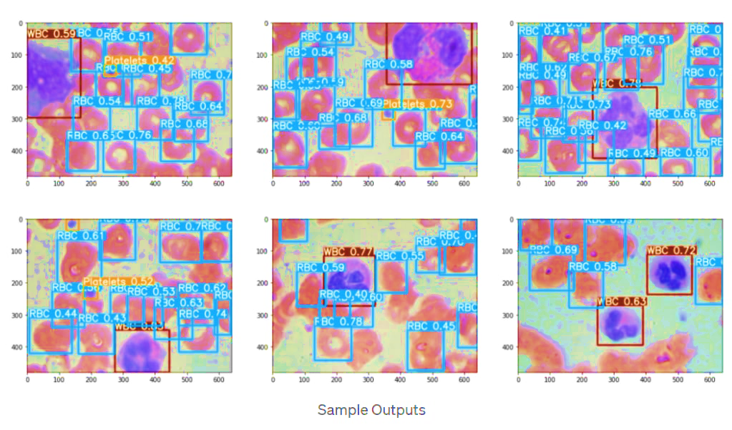
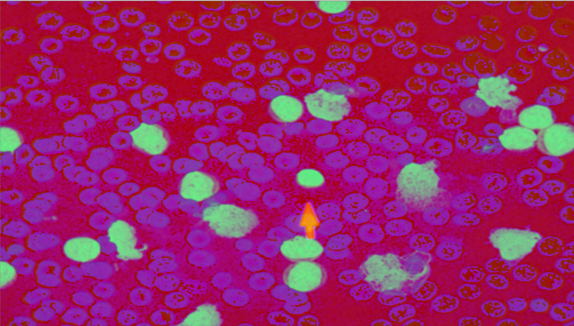
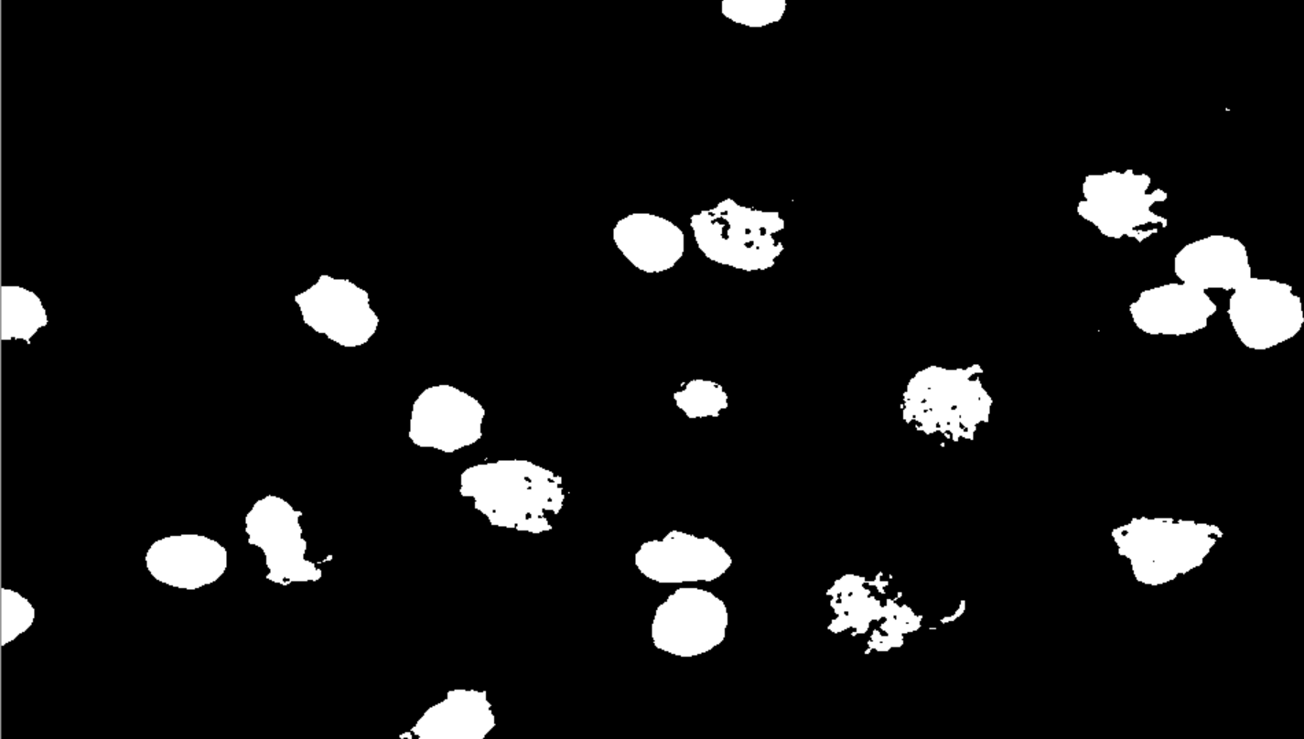
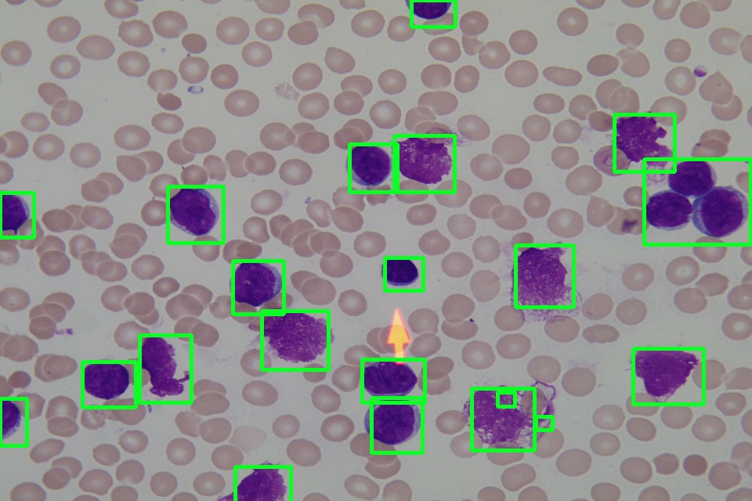
Task 1: Blood Cell Detection
Single Shot Multi-box Detector
SSD based on pretrained VGG16
Supervised
SSD based on pretrained AlexNet
Cell Detection
Minimum enclosing location boxes for detected objects [1]
HSV Space
Binarize Image
Smear Image
Unsupervised
(OpenCV Segmentation)
[1] Zhao, J., Zhang, M., Zhou, Z. et al. Automatic detection and classification of leukocytes using convolutional neural networks. Med Biol Eng Comput 55, 1287–1301 (2017). https://doi.org/10.1007/s11517-016-1590-x

Slide 6
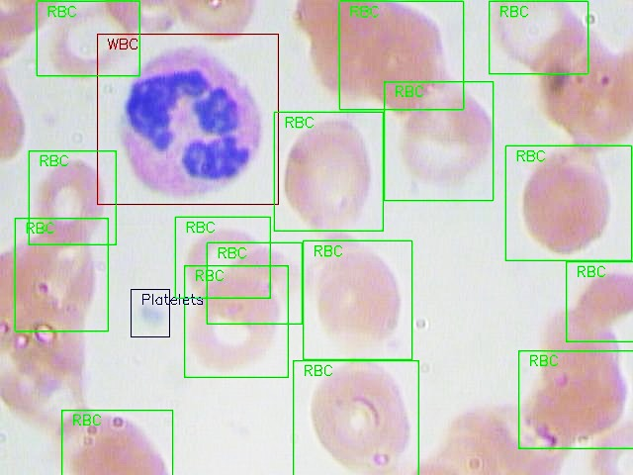
Dataset 1
BCCD Dataset
This data contains images with three different types of objects: WBC , RBC, Platelets
Each object is represented by
a bounding box in absolute boundary coordinates
a label
a perceived detection difficulty (either 0, meaning not difficult, or 1, meaning difficult)
An example of the labeled cell image.
https://github.com/Shenggan/BCCD_Dataset

Slide 7
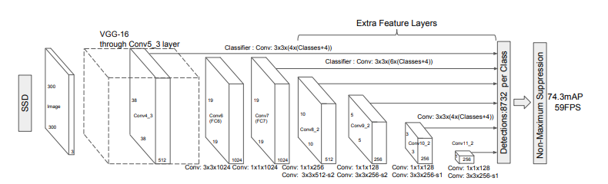
Model: Single Shot Detection (SSD)
The SSD is a purely convolutional neural network (CNN) that is organized into three parts
Base convolutions derived from an existing image classification architecture that will provide lower-level feature maps.
Auxiliary convolutions added on top of the base network that will provide higher-level feature maps.
Prediction convolutions that will locate and identify objects in these feature maps.
Liu, Wei, et al., European conference on computer vision. Springer, Cham, 2016

Slide 8
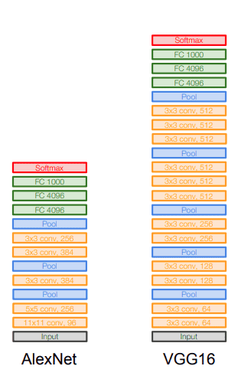
Base Convolutions
Why use convolutions from an existing network architecture?
Because models proven to work well with image classification are already pretty good at capturing the basic essence of an image.
The same convolutional features are useful for object detection, but in a more local sense – we're less interested in the image as a whole than specific regions of it where objects are present.

Slide 9
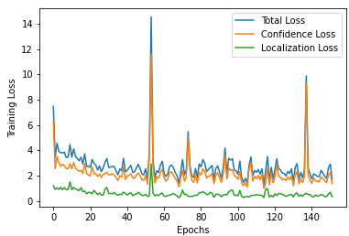
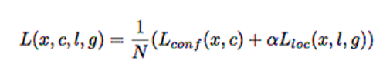
Multibox Loss
Learning Procedure SSD VGG16-based
The MultiBox loss, a loss function for object detection.
This is a combination of:
(1) a localization loss for the predicted locations of the boxes
(2) a confidence loss for the predicted class scores.
Loss:
Object detection parameters:
batch_size = 8
Learning rate = 0.001
epochs =150
optimizer = adam
Class Label Loss
Localization Loss

Slide 10
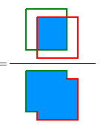
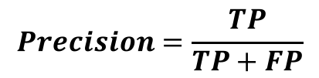
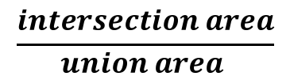
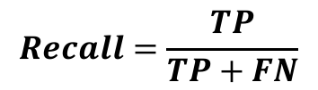
Evaluation
Metrics:
Intersection over Union (IOU)
Precision:
True Positive (TP): A correct detection. Detection with IOU ≥ threshold
False Positive (FP): A wrong detection. Detection with IOU < threshold
False Negative (FN): A ground truth not detected
$$\frac{intersection area}{union area }$$
$$Precision=\frac{TP}{TP+FP}$$
$$Recall=\frac{TP}{TP+FN}$$
 |  | SSD Alexnet-base |  | SSD VGG16-base
 |  | Precision | Recall | Precision | Recall
Average Precision | WBC | 0.8955 | 0.8407 | 0.9972 | 1.0
 | RBC | 0.6873 | 0.8788 | 0.7961 | 0.8973
 | Platelet | 0.1471 | 0.3018 | 0.7367 | 0.8296
Mean Average Precision (mAP) |  | 0.362 |  | 0.841

Slide 11
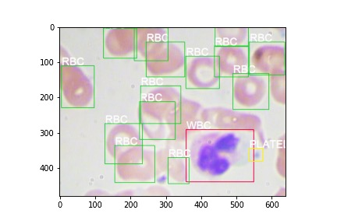
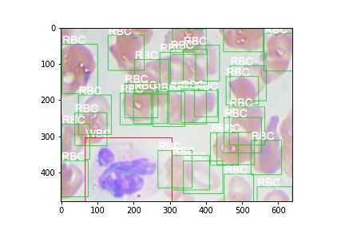
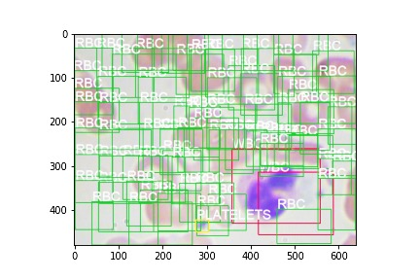
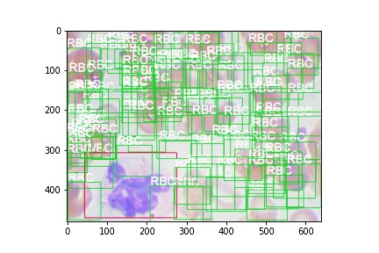
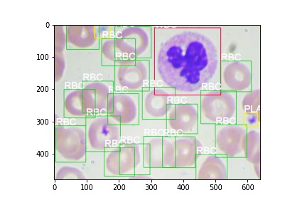
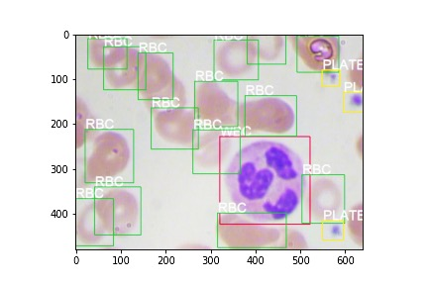
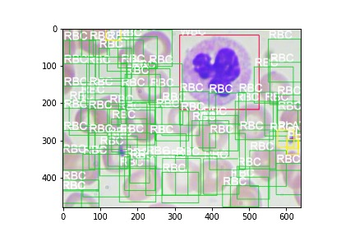
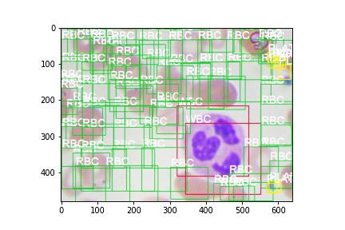
Detection with trained models
VGG-based SSD
Alexnet-based SSD
High false positive for RBC

Slide 12
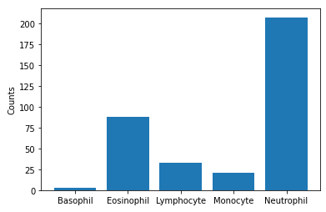
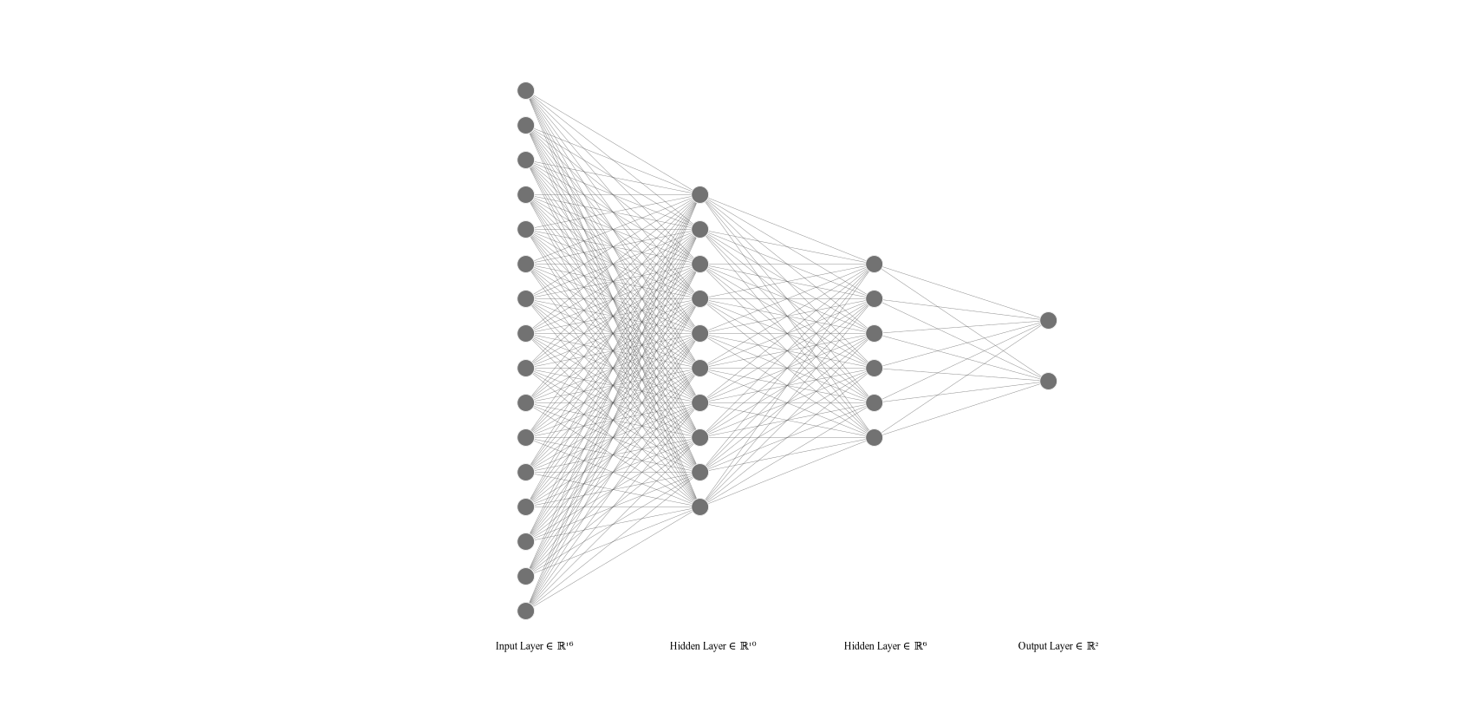
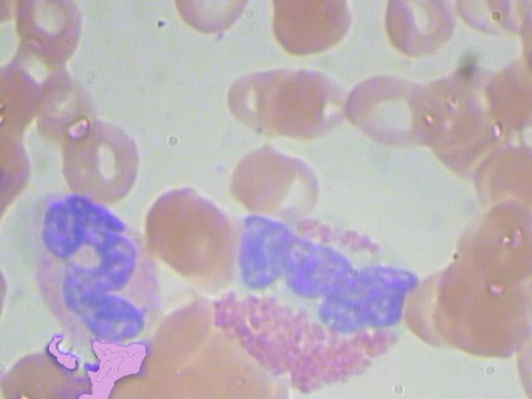
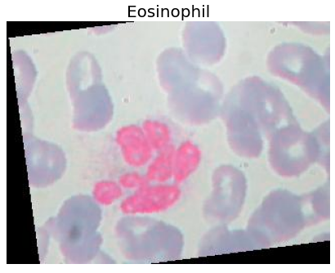
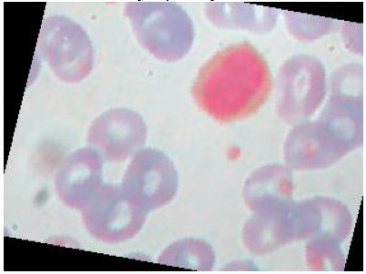
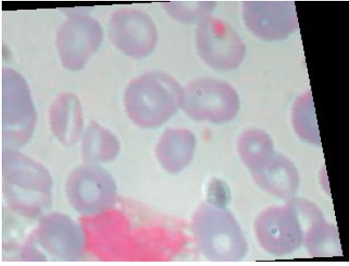
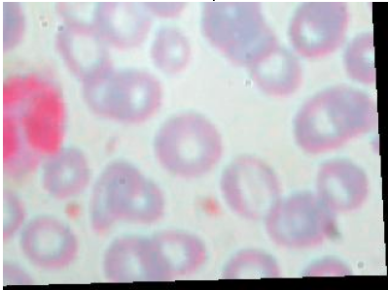
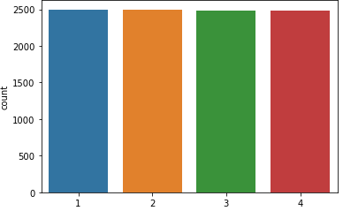

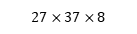
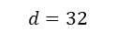
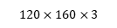
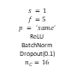
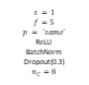
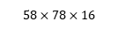
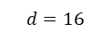
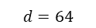
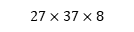
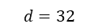

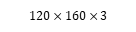
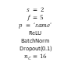
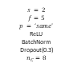
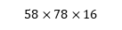

Task 2: WBC Cell Type Classification
Imbalanced Data
$$s = 2$$
$$f=5$$
$$p = ‘same’$$
ReLU
BatchNorm
Dropout(0.1)
$$n_{C}=16$$
$$s = 2$$
$$f=5$$
$$p = ‘same’$$
ReLU
BatchNorm
Dropout(0.3)
$$n_{C}=8$$
$$d=32$$
$$d=16$$
$$d=8$$
$$d=16$$
Customized Architecture 1
$$58×78×16$$
$$27×37×8$$
$$120×160×3$$
$$s =1$$
$$f=5$$
$$p = ‘same’$$
ReLU
BatchNorm
Dropout(0.1)
$$n_{C}=16$$
$$s =1$$
$$f=5$$
$$p = ‘same’$$
ReLU
BatchNorm
Dropout(0.3)
$$n_{C}=8$$
$$d=32$$
Customized Architecture 2
$$d=16$$
$$d=64$$
$$d=8$$
Augmentation
(rotation, zoom, random crop)
Eosinophil
Lymphocyte
$$120×160×3$$
$$58×78×16$$
$$27×37×8$$
Pre-trained ResNet50
Monocyte
Neutrophil
Pre-trained DenseNet121
Pre-trained VGG16
Pre-trained MobileNet-v2
Pre-trained Xception
Pre-trained Inception
Balanced Data

Slide 13




Learning – pretrained architecture
Pre-trained Models

Slide 14




Learning – customized architectures
Architecture 1
Architecture 2

Slide 15

Evaluation
 | Accuracy score | Precision | Recall | F1-score
Customized Arch1 | 0.58 | 0.52 | 0.58 | 0.53
Customized Arch2 | 0.76 | 0.72 | 0.79 | 0.74
Pretrained ResNet50 | 0.35 | 0.26 | 0.34 | 0.27
Pretrained DenseNet121 | 0.74 | 0.76 | 0.73 | 0.73
Pretrained VGG16 | 0.66 | 0.69 | 0.65 | 0.64
Pretrained MobileNet-v2 | 0.7 | 0.7 | 0.7 | 0.7
Pretrained Xception | 0.55 | 0.56 | 0.55 | 0.55
Pretrained Inception | 0.64 | 0.62 | 0.62 | 0.62
Architecture 2- Confusion Matrix

Slide 16






Feature Map Visualization
DensNet121

Slide 17






Feature Map Visualization
Architecture 2

Slide 18
Task 3: COVID-19 Diagnosis by Cell Counts
Logistic Regression
K-Nearest Neighbor
Linear SVM
Non-Linear SVM
Gaussian Process Classifier
Decision Tree
Random Forest
MLP
AdaBoost
Feature Descriptions
Feature | Type
Platelets | Numerical (Continuous)
WBC | Numerical (Continuous)
Lymphocytes | Numerical (Continuous)
Basophils | Numerical (Continuous)
Neutrophils | Numerical (Continuous)
Covid | Binary
COVID-19 Classification
Positive
Negative
Number of Data Samples = 201

Slide 19

Evaluation
 | Covid | Accuracy score | Precision | Recall | F1-score | False negative (%)
Logistic Regression | negative | 0.87 | 0.84 | 0.89 | 0.86 | 7.89
 | positive |  | 0.89 | 0.85 | 0.87
10-Nearest Neighbors | negative | 0.89 | 0.89 | 0.89 | 0.89 | 5.26
 | positive |  | 0.90 | 0.90 | 0.90
Linear SVM | negative | 0.87 | 0.84 | 0.89 | 0.86 | 7.89
 | positive |  | 0.89 | 0.86 | 0.87
NonLinear SVM | negative | 0.84 | 0.83 | 0.83 | 0.83 | 7.89
 | positive |  | 0.85 | 0.85 | 0.85
Gaussian Process Classifier | negative | 0.89 | 0.89 | 0.89 | 0.89 | 5.26
 | positive |  | 0.90 | 0.90 | 0.90
Decision Tree | negative | 0.82 | 0.79 | 0.83 | 0.81 | 10.53
 | positive |  | 0.84 | 0.82 | 0.80
Random Forest | negative | 0.76 | 0.74 | 0.768 | 0.76 | 13.16
 | positive |  | 0.79 | 0.75 | 0.77
MLP | negative | 0.87 | 0.84 | 0.89 | 0.86 | 7.89
 | positive |  | 0.89 | 0.85 | 0.87
AdaBoost | negative | 0.84 | 0.89 | 0.89 | 0.84 | 10.53
 | positive |  | 0.89 | 0.80 | 0.84
Gaussian Process Classifier Confusion Matrix

Slide 20
Conclusion
Automated blood cell count from smear image for COVID diagnosis
Blood cell detection with VGG-based SSD model
White Blood cell subtype classification with pretrained DenseNet121 and a customized architecture 2
COVID-19 diagnosis based on blood cell and subtypes count with Gaussian process and 10-nearest neighbors classifiers

Slide 21
Thanks for your attention !
Any Question ?

